Slide 1
Problem Definition

Slide 2
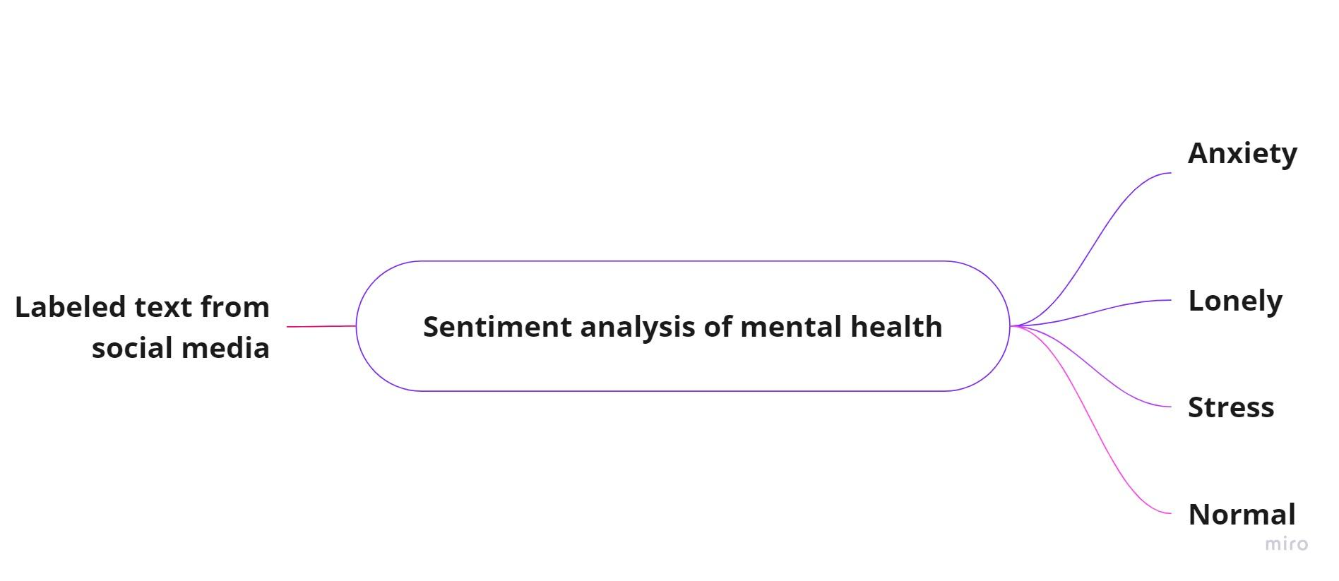
Problem Definition

Slide 3
Motivation

Slide 4
Motivation
Social media become a fertile field to get society insight
People’s interaction over social media has a significant increasing over last years
Sentiment analysis reflection for society and companies
Italy story with covid19

Slide 5
Methodology

Slide 6
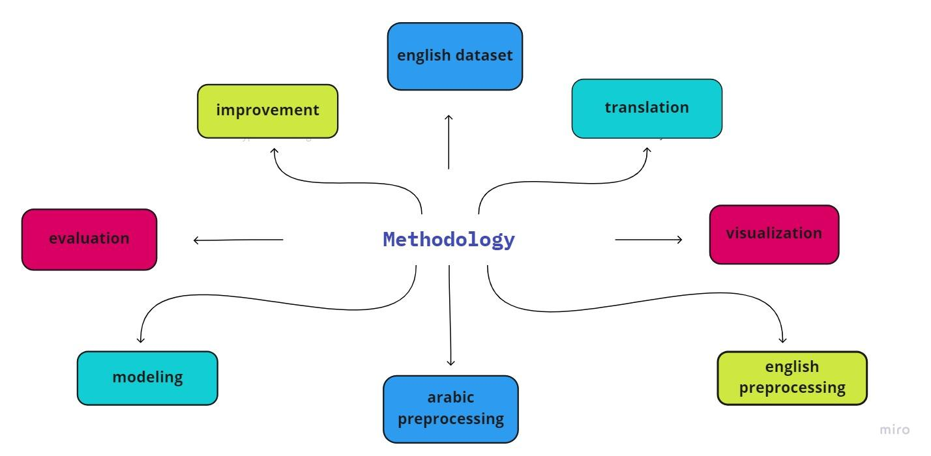
Methodology

Slide 7
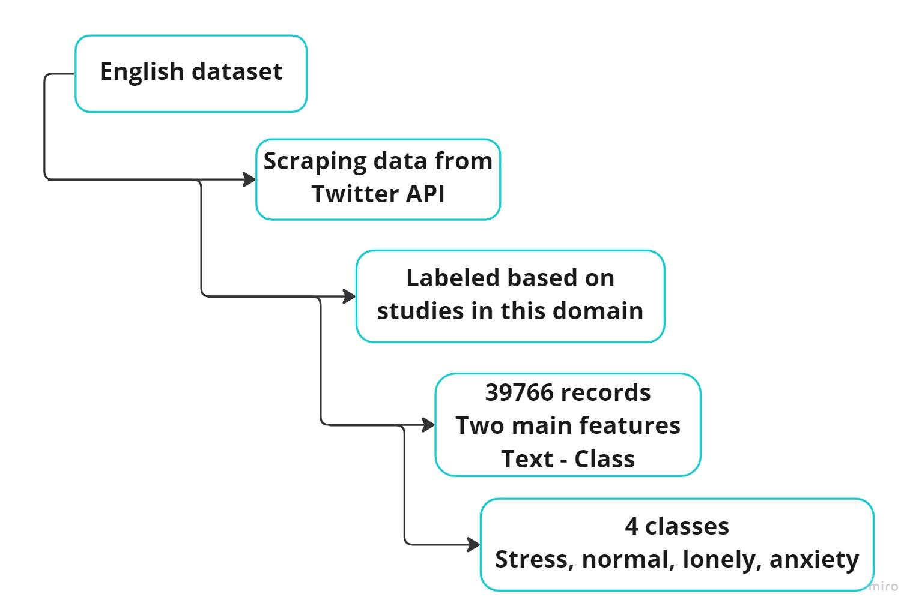
English dataset

Slide 8
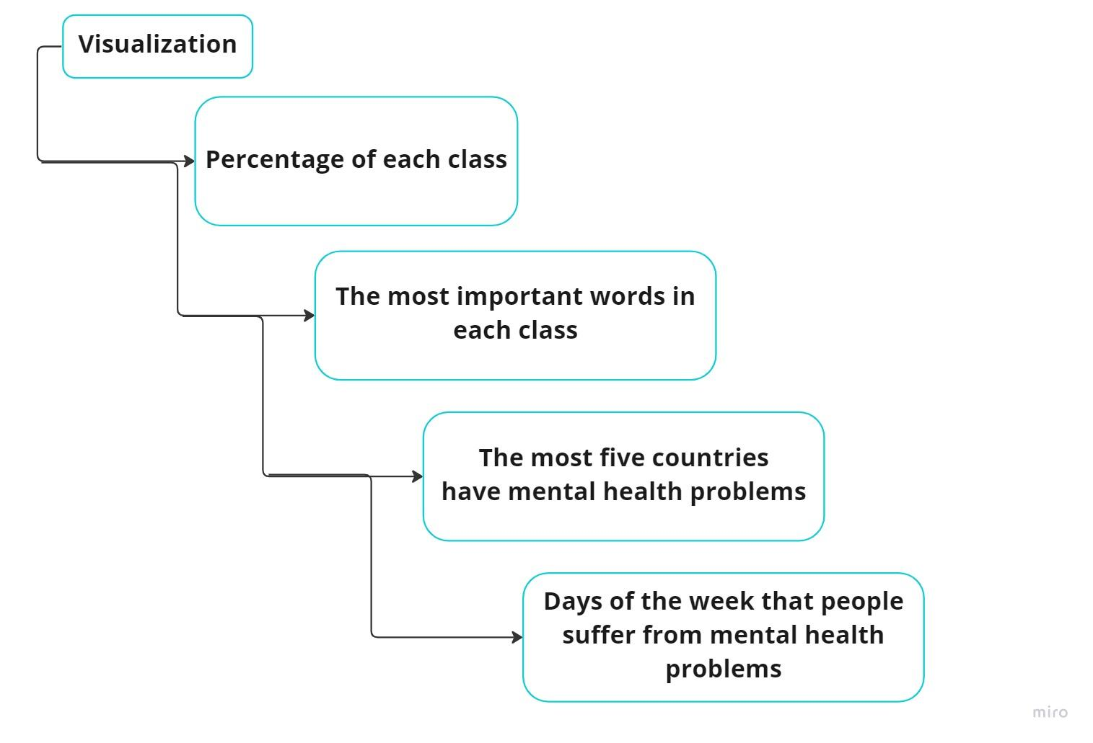
Visualization

Slide 9
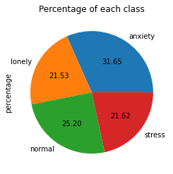
Visualization
The percentage of each class

Slide 10
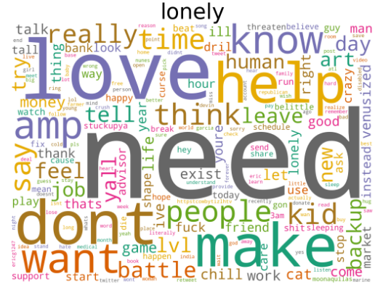
Visualization
The most important words in lonely class

Slide 11
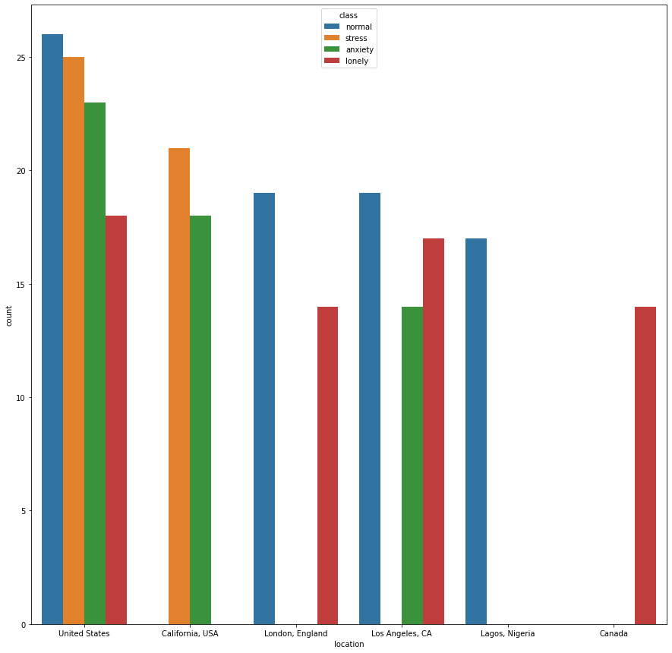
Visualization
The most five countries
have mental health problems

Slide 12
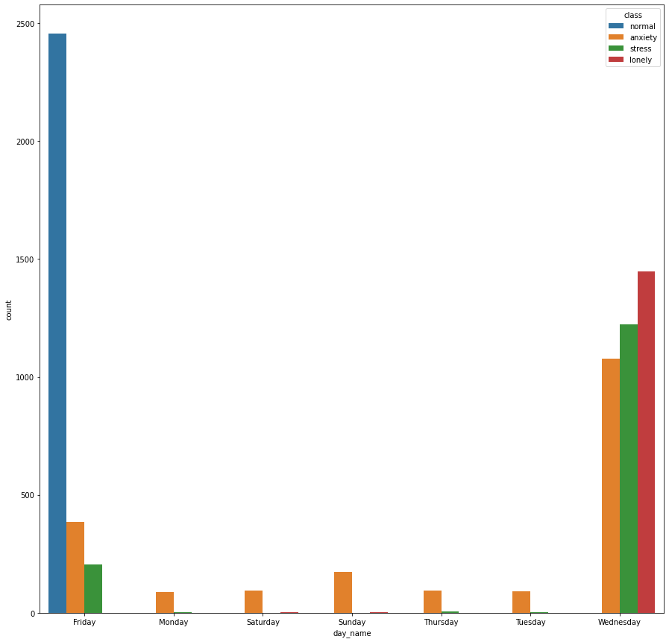
Visualization
Days of the week that people suffer
from mental health problems

Slide 13
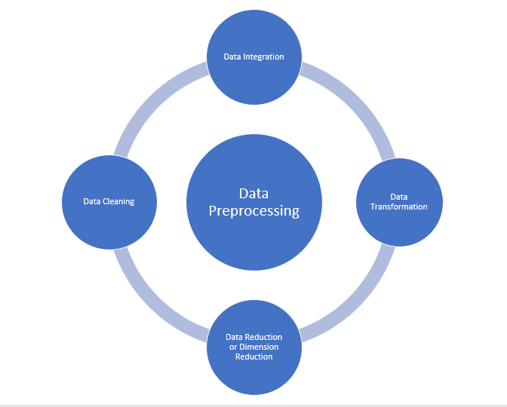
Preprocessing

Slide 14
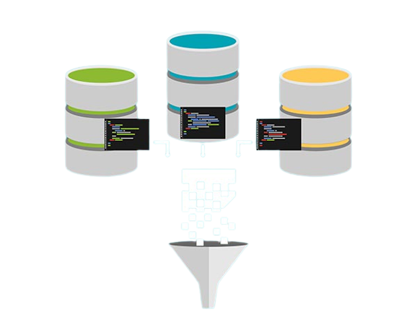
Integration

Slide 15
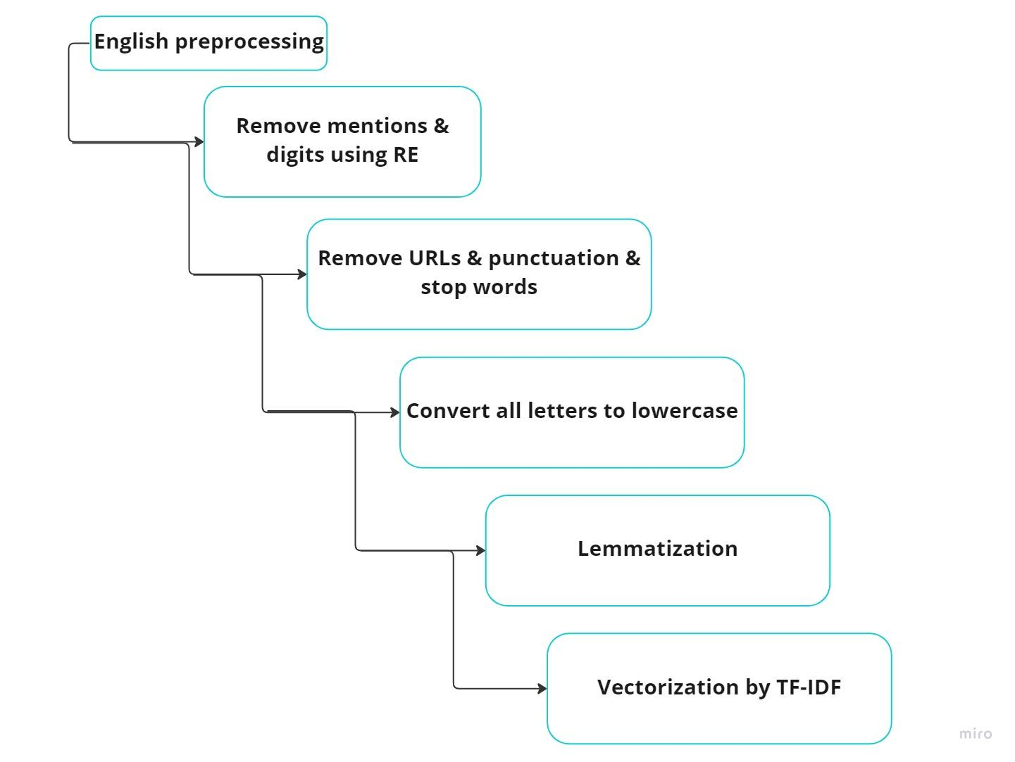
English preprocessing

Slide 16
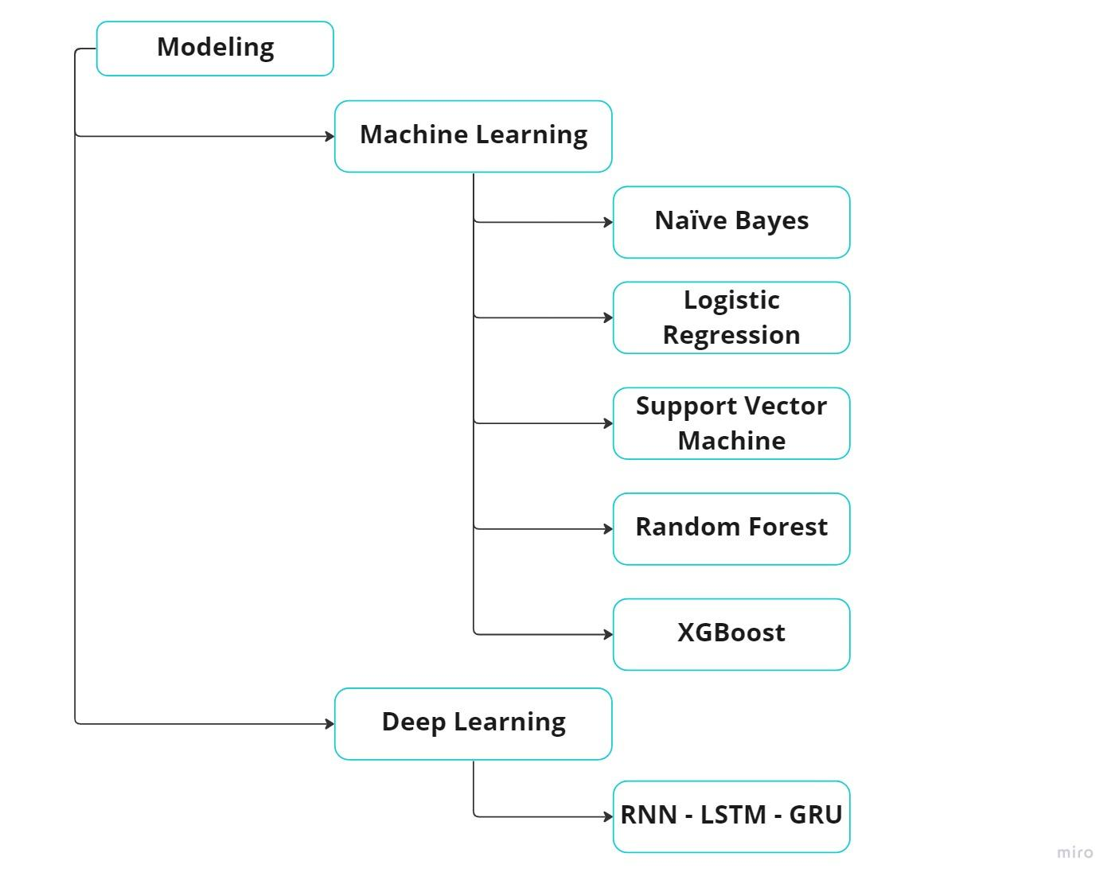
Modeling

Slide 17
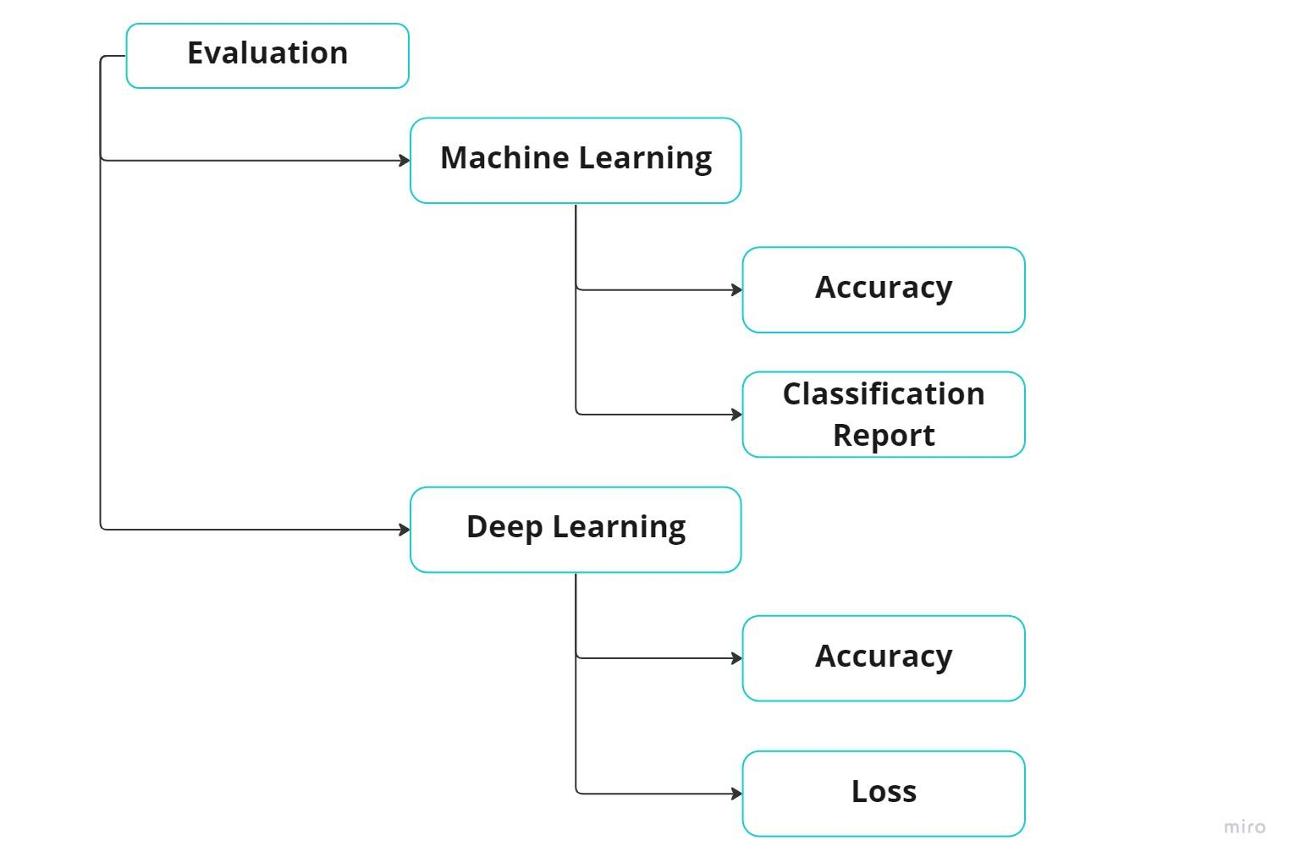
Evaluation

Slide 18
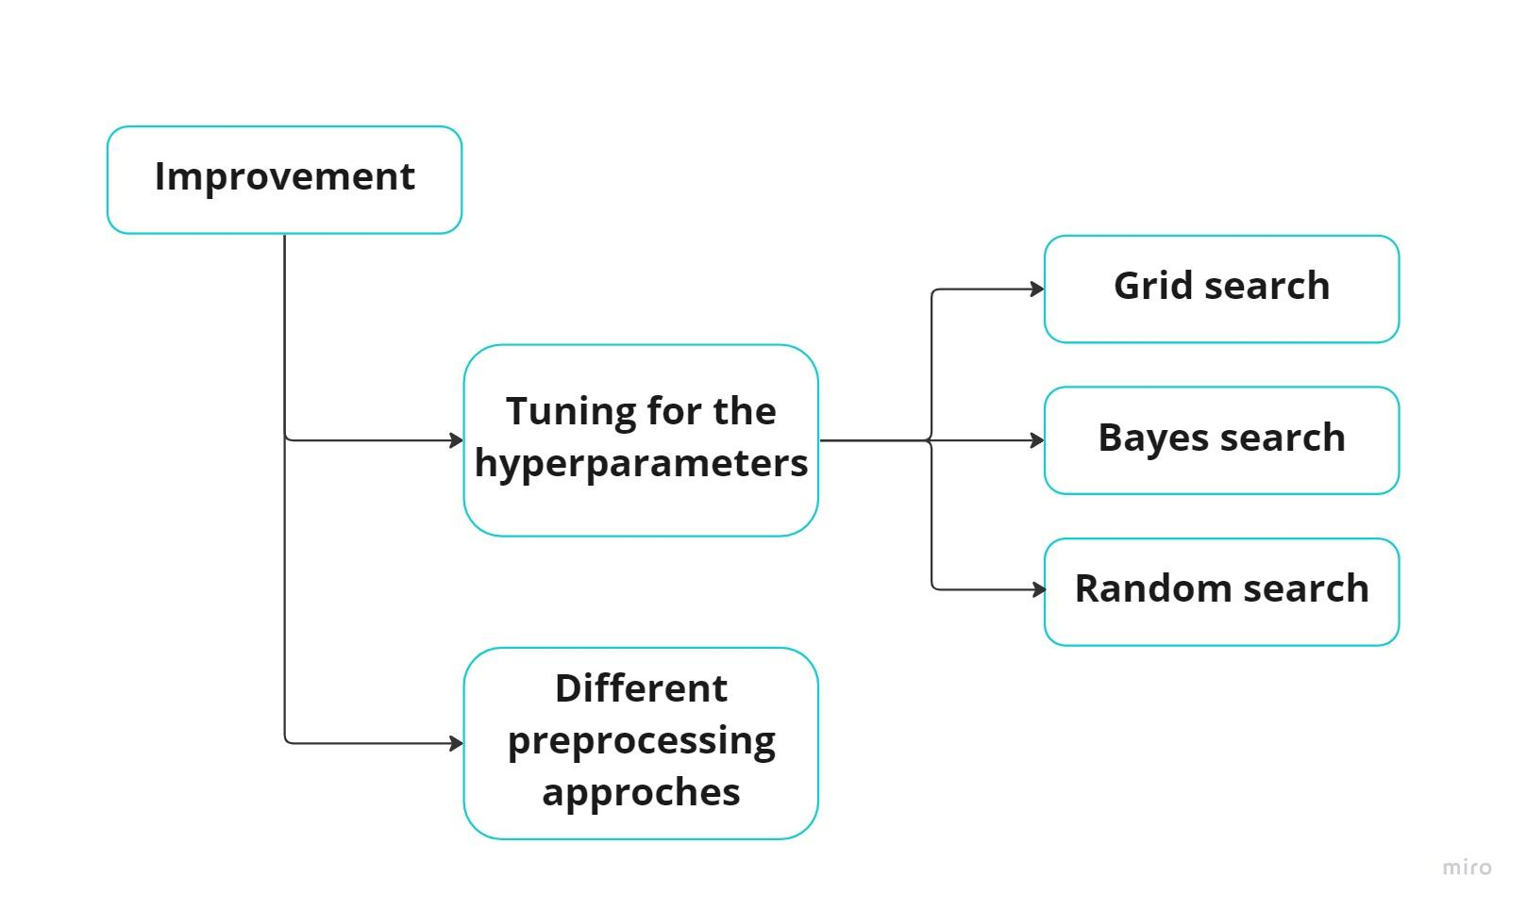
Improvement

Slide 19
Results

Slide 20
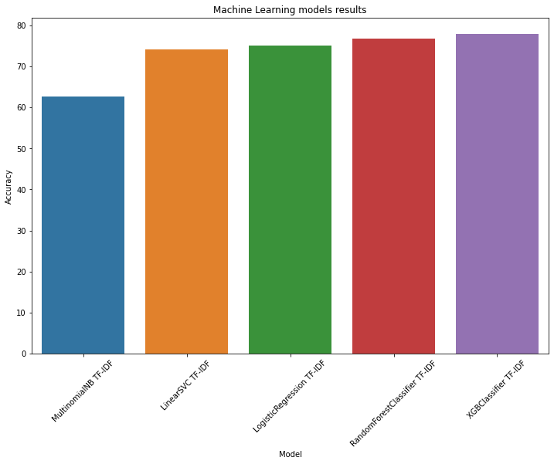
Results (ML)

Slide 21
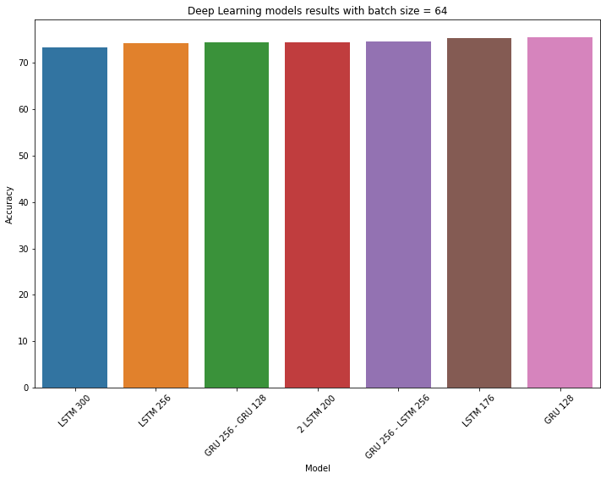
Results (DL)

Slide 22
Concolusion

Slide 23
Conclusion
We had challenges with the Arabic dataset, so we depend on the English dataset to get the Arabic dataset Using translation. We also used combinations of preprocessing techniques that were mentioned on papers to get clean data and try different vectorization techniques like TF-IDF, count vector, and word2vec to improve the results.
Finally, we applied both machine learning and deep learning models in Arabic and English datasets, but Machine Learning models like the Random Forest gave us high-accuracy results in the Arabic dataset and in the English dataset, and deep learning models like RNN-GRU gave us high accuracy in English dataset.

Slide 24
Thank you

